Slide 1
Summarizer: A Chat-Based System for Transcribing and Querying Audio, Video and YouTube Sources
Abdelrahman Qazzaz
Supervisor: Dr. Kholoud Nairokh
Department of Computer Science, School of Computing — German Jordanian University, 2026
Notes:
Nothing. Read the room, then move on. Don't narrate your own title slide.

Slide 2
02
The problem
▪ More and more information arrives as speech: lectures, meetings, interviews, video
▪ Speech is easy to record, hard to use
▪ You can't search it, quote it, or compare two of them
2
Notes:
Open with the concrete version: "You have a ninety-minute recorded lecture and one question about it. Right now your only option is to scrub through it."
That's the whole problem in one sentence. Don't over-explain.

Slide 3
03
Why transcription alone isn't the answer
▪ Transcription turns an unsearchable medium into a long one
▪ 90 minutes → tens of thousands of words
▪ The reader still has to find the answer themselves
3
Notes:
This is the slide that justifies the project existing. Transcription services stop here and call it done.
What changed: LLMs can take a long text as context and answer a specific question about it. So: transcribe, then ask.

Slide 4
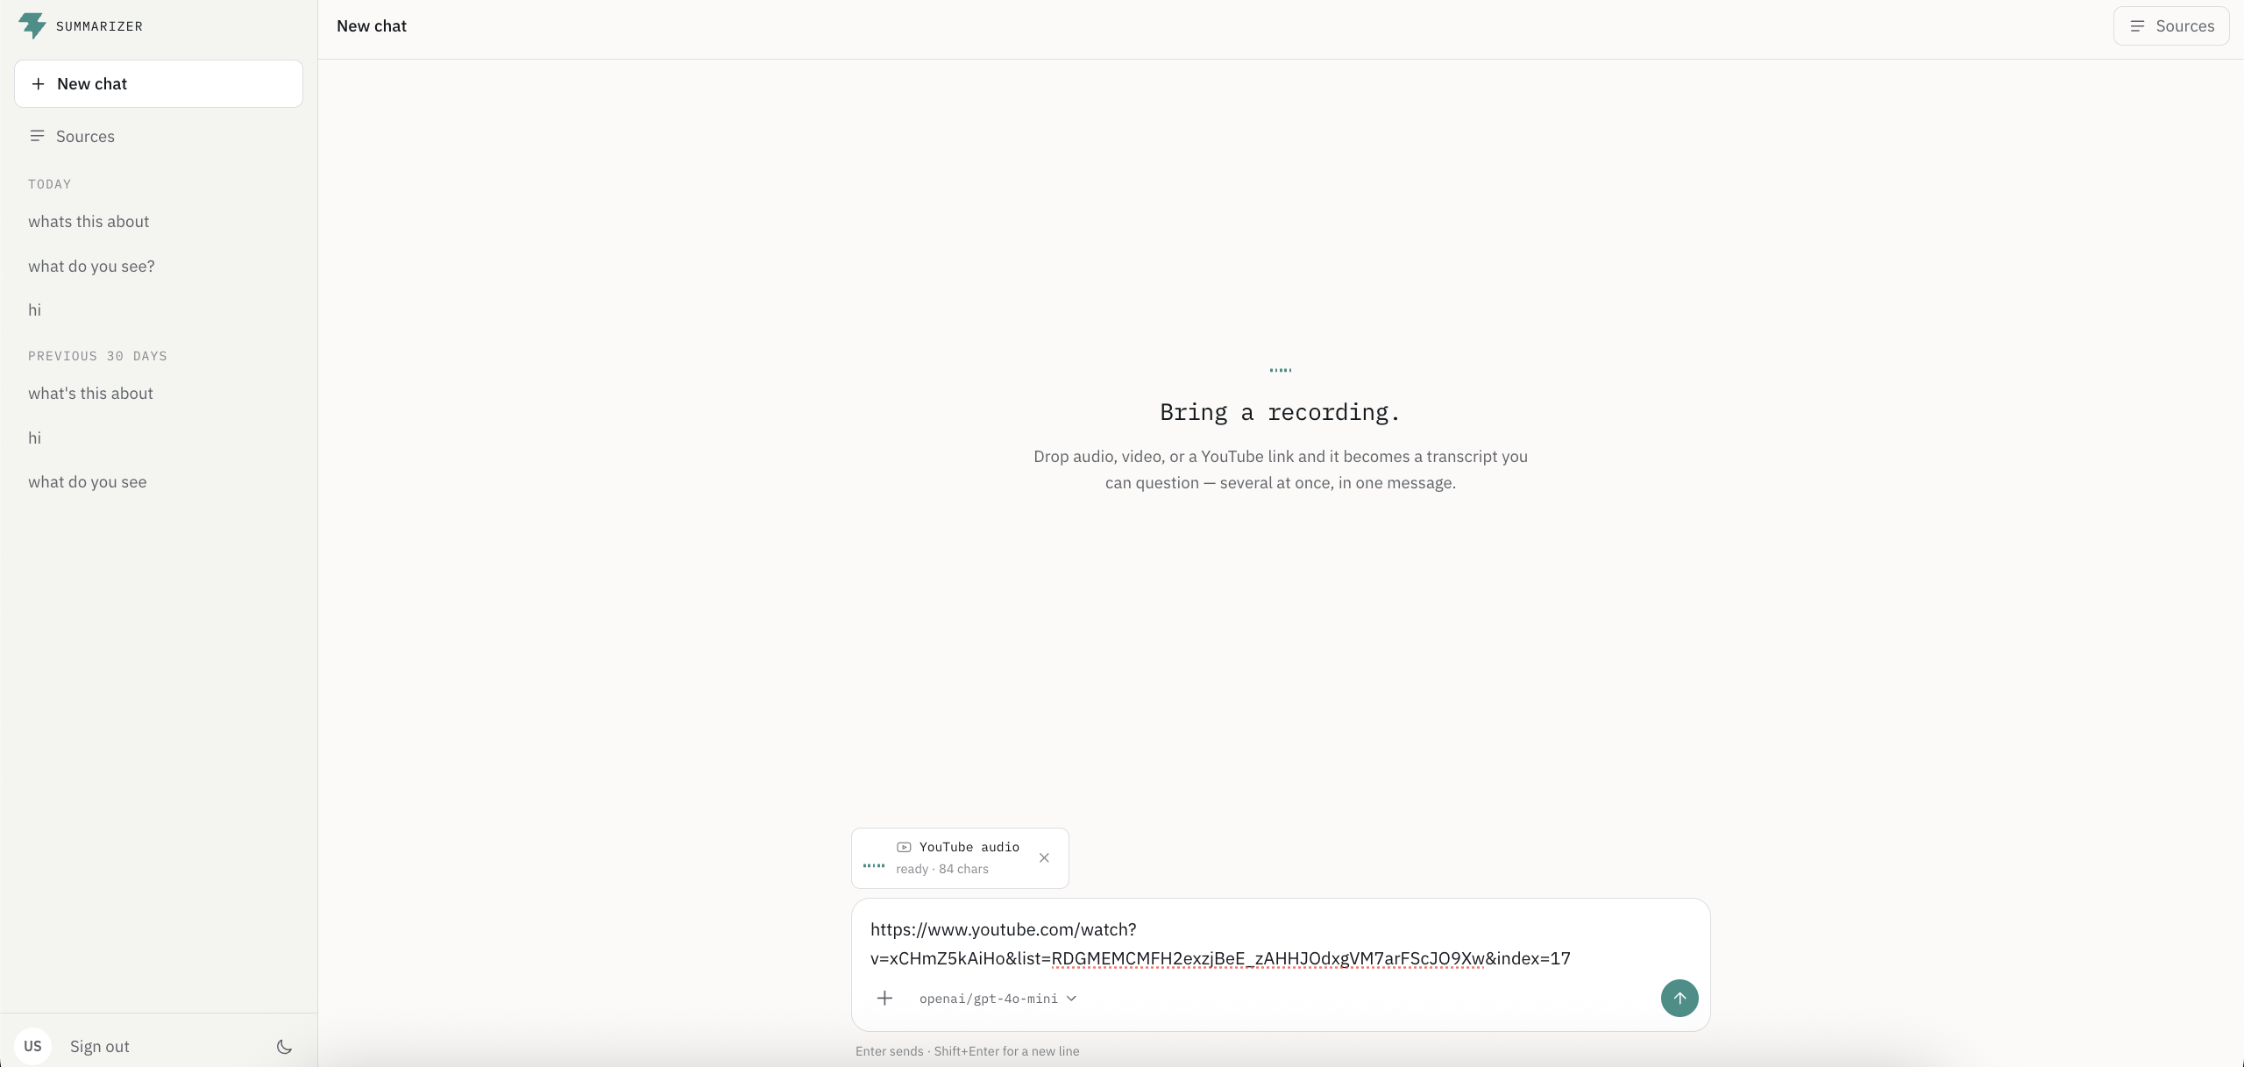
04
What Summarizer does
▪ Submit audio, video, or a YouTube link
▪ System extracts speech → transcribes → stores it
▪ Ask questions in chat — several transcripts at once, in one message
4
Notes:
Land the differentiator here, early: one message can carry several recordings.
The interesting questions are comparative — "where do these two lectures disagree" — and those need multiple transcripts in front of the model at the same time.

Slide 5
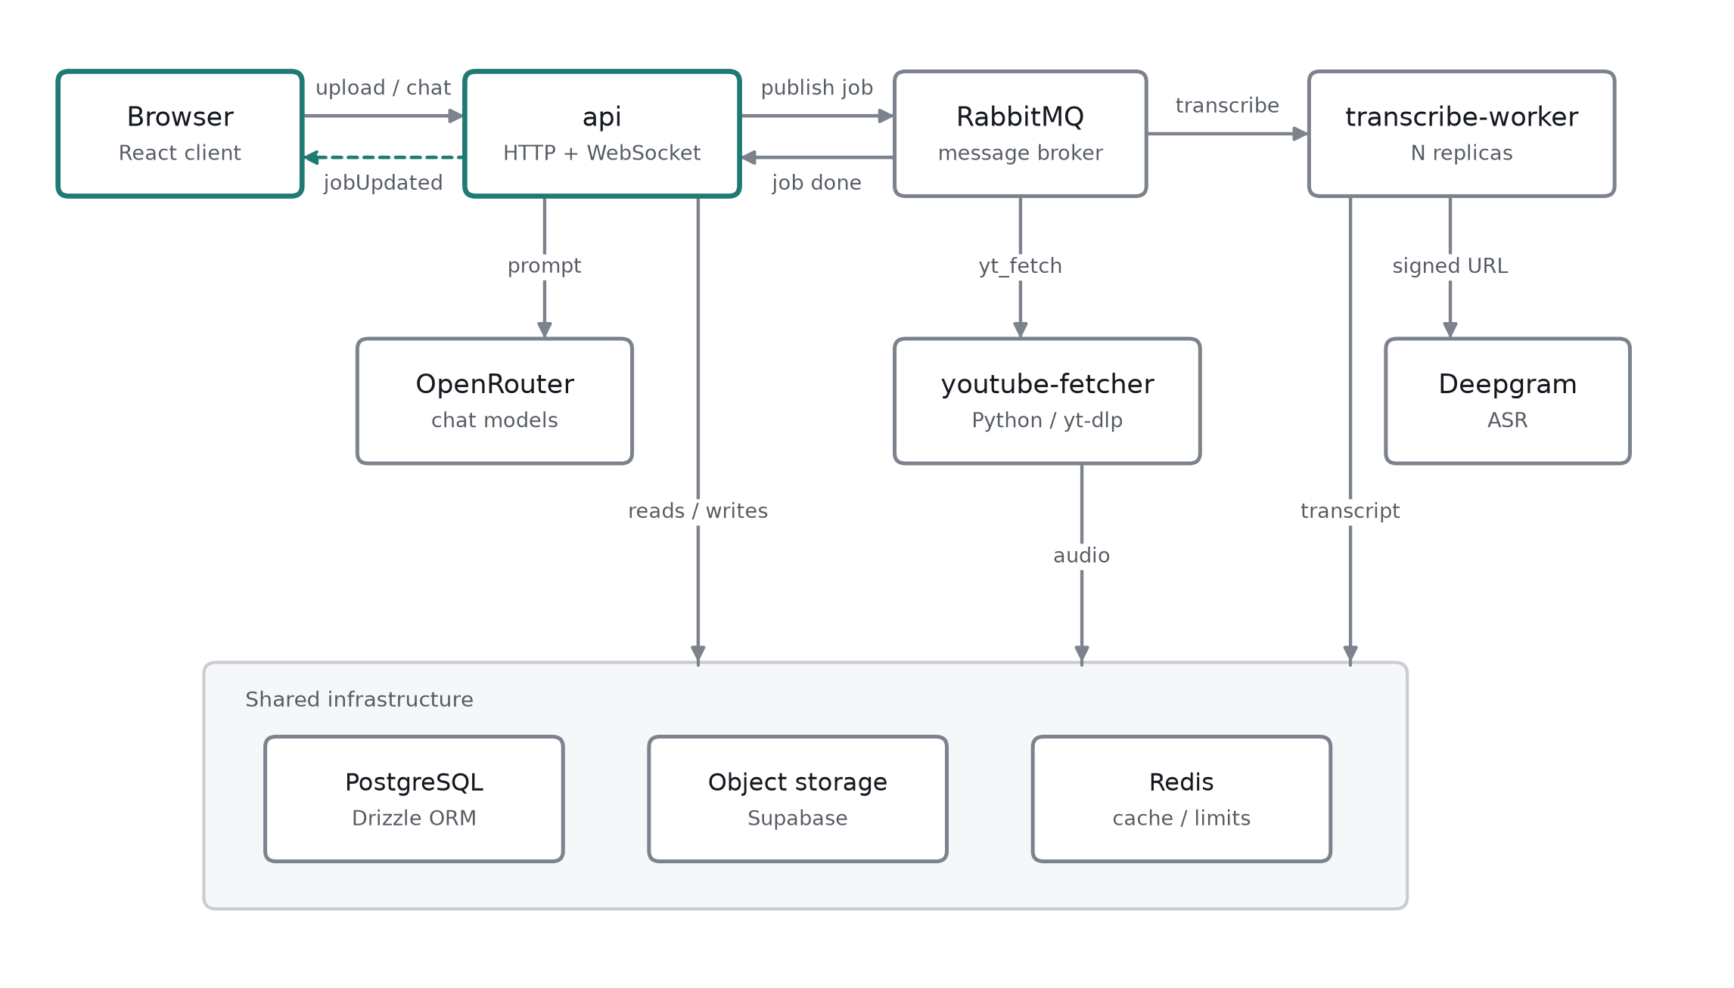
05
Architecture
▪ Modular monolith: one artifact, three process types
— api — HTTP + WebSocket
— transcribe-worker — queue consumer, N replicas
— youtube-fetcher — Python, yt-dlp
▪ RabbitMQ · PostgreSQL · object storage · Redis
5
Notes:
Justify the choice before they ask: not microservices, because the processes share one database and one deploy. Separate services would add operational cost and buy nothing.
What I actually needed was to scale transcription independently of the API — the message queue gives me that on its own.
Workers are competing consumers, so scaling is a replica count. No load balancer: workers pull.

Slide 6
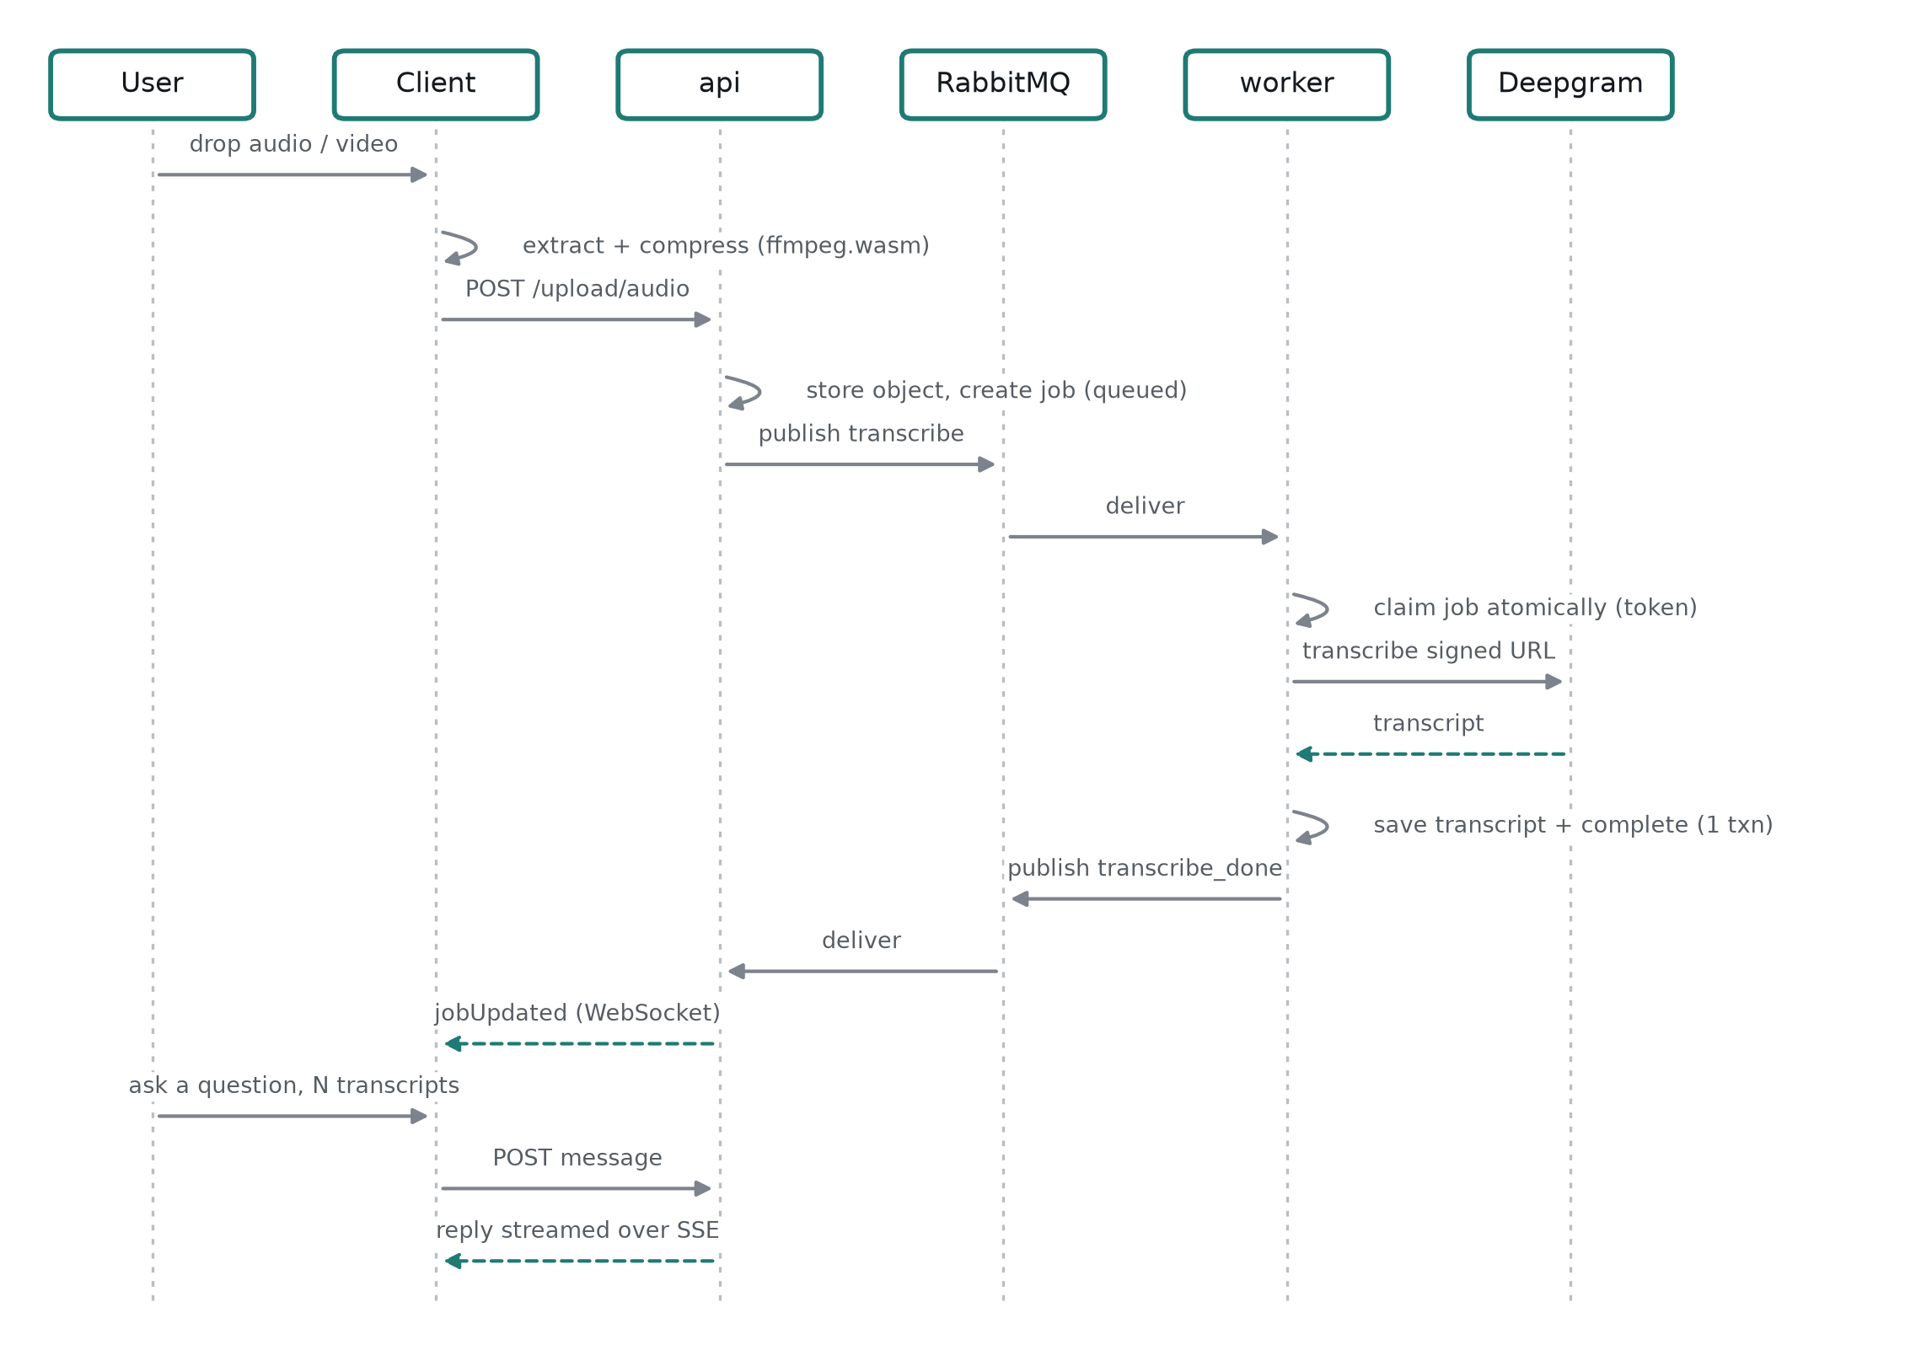
06
End to end: upload to answered question
6
Notes:
Walk it once, briefly. The only step that needs emphasis is 'claim job atomically' — that is the next slide.
Note that the reply streams over SSE while the job pipeline is entirely asynchronous behind it.

Slide 7
07
Correctness: atomic claiming and fencing tokens
▪ Transcription is slow, paid, and can fail — it can't run in a request
▪ RabbitMQ redelivers an unacknowledged message when a consumer's connection drops
▪ …but the original worker may still be alive and still finish
▪ Fix: claim atomically, stamp a new token, make every terminal write conditional on still owning it
▪ Transcript + completion are written in one transaction
7
Notes:
This is your strongest engineering slide. Slow down here.
Walk the failure: worker A gets partitioned → broker redelivers → worker B transcribes and writes → worker A comes back and writes a stale result over it.
The claim is one conditional UPDATE: a fresh delivery may claim only a queued job, a redelivery may reclaim a processing one. Every claim writes a new token. A superseded worker's write matches no row and is discarded.
If asked where you got it: this is the standard fencing-token pattern (Kleppmann, ref [7]).

Slide 8
08
Multiple transcripts per message
▪ Join table with a `position` column → an ordered list, not a single reference
▪ Order staged = order persisted = order the model receives
▪ Attached transcripts replay on later turns
▪ Attaching an existing transcript costs nothing — no re-upload, no re-transcription
8
Notes:
This is the feature the whole system is designed around, and it shows up at every layer: schema, context assembly, UI.
The 100,000-character context budget is spent using stored charCount values, so I decide which transcripts fit without reading any of them, then fetch only the ones admitted.
Note the cost argument — transcription is paid, so referencing by ID instead of copying is a money decision, not just a tidy one.

Slide 9
09
Streaming replies
▪ Replies stream over Server-Sent Events
▪ The model run is decoupled from the response stream
▪ Client disconnects mid-answer → the turn still completes and is still stored
▪ The stored conversation is the source of truth, not the stream
9
Notes:
A dropped connection is a display problem, not a data-loss problem. The client refetches and the answer is there.
Why not EventSource: it can't send a POST body, so the client uses fetch plus a stream reader.
If asked "why no Stop button": stopping the stream wouldn't stop the model or the cost, and the reply would reappear on refetch. Deliberate, not missing.

Slide 10
10
Client-side media preparation
▪ Video is decoded and audio extracted in the browser (ffmpeg.wasm)
▪ Re-encoded to mono, 16 kHz Opus — matched to speech recognition
▪ The original video never leaves the device
▪ Concurrent jobs serialised — one FFmpeg instance, one filesystem
10
Notes:
Faster uploads, less storage, and a privacy story you get for free.
The serialisation point is a real bug I hit: two files dropped together overwrote each other's working files, because it's one WebAssembly instance with one virtual filesystem.

Slide 11
Live demo
Fallback recording ready
Notes:
Paste a YouTube link → the prompt offers to transcribe it → accept.
While it transcribes, drop a second recording. Point at the meters running.
Show send is disabled, and the line naming what it's waiting for.
Both land → ask a comparative question across both.
Answer streams in.
Open the sources drawer → attach an older transcript to a new message with no re-upload.
Have a recorded fallback. Live transcription depends on a paid third-party API and the venue's WiFi.
Use a short clip. Don't stand there while a 90-minute lecture transcribes.

Slide 12
12
Engineering practice
▪ 174 source files · 312 commits · 25 test files, 174 test cases
▪ API tests · unit tests · worker tests · Python fetcher tests
▪ Fail-fast preflight on every process
▪ Rate limiting per user; per-user object namespacing
12
Notes:
Tests target the correctness-critical paths: job claiming, transcript persistence, queue publisher and consumer.
Preflight: if a dependency is down, the process aborts instead of starting half-alive and failing later in a confusing way.
If asked why the report says 30 files / 169 cases: that count was taken before the last change and was slightly off; these are the current numbers.

Slide 13
13
Known limitations
▪ Retried requests aren't idempotent → a lost response can duplicate a paid job
▪ A failed re-run can get stuck queued
▪ Dead-letter exchanges declared but not wired
▪ Message history isn't paginated
13
Notes:
Do not skip this slide. Volunteering your own limitations is the single best move in a defence — it moves you from defending to discussing, and it pre-empts the question they were going to ask anyway.
Real example, worth telling: a YouTube fetch hit a transient 403 from the media CDN. It succeeded on a manual retry — but the handler nacks without requeue, so the job had been dropped rather than retried. I've since added retry-with-re-extraction in the fetcher (the signed URL is what gets rejected, so a retry has to re-extract), but the queue-level dead-letter gap above is still open.
Each one has a known fix: idempotency keys on the write endpoints, a recovery path for requeue, wiring the retry/DLX topology, cursor pagination.
These are documented in the repo, not discovered this morning.

Slide 14
14
Future work
▪ Close the limitations above first
▪ Speaker diarisation and timestamped citations back to the audio
▪ Retrieval over transcripts to lift the context ceiling
▪ Sharing a conversation
14
Notes:
Timestamped citations is the strongest one — "the model claims X, here's the second in the recording where it was said." It attacks the trust problem directly.
Retrieval matters because the current design puts whole transcripts in context; that has a hard ceiling. Selecting relevant spans is the documented approach for long meeting transcripts (ref [6]).

Slide 15
15
Summary
▪ Speech → transcript → conversation
▪ Several recordings, one question
▪ Asynchronous by necessity, correct under redelivery
▪ Thank you — questions?
15
Notes:
Three sentences maximum, then stop talking and let them ask.

Slide 16
APPENDIX
Anticipated questions
They ask | Your answer
Why not microservices? | Shared database, shared deploy cadence. The only thing I needed was independent scaling of transcription, and the queue gives me that without the operational cost.
Why not train your own ASR model? | Out of scope and worse. Large weakly-supervised models (ref [3]) generalise across accents and domains zero-shot; the engineering contribution here is the system around it.
What if two workers process the same job? | Fencing tokens — slide 6. Only the current claimant can write.
What stops one user reading another's data? | Every table is keyed by owner and every query is scoped by it; storage keys are namespaced per user, so a non-owner's request fails structurally.
How much does it cost to run? | Transcription and model calls are the paid parts. That's why transcripts are referenced by ID rather than re-transcribed, and why rate limits are per user.
How accurate is the transcription? | I use a hosted ASR service and expose its model choice, including re-running a recording with a different model. I haven't benchmarked accuracy myself — say so plainly, don't invent a number.
Why is there no Stop button? | Slide 8. Aborting the stream stops neither the model nor the cost, and the reply reappears on refetch.
Notes:
Keep this slide hidden unless a question lands on it.
If you do not know an answer, say so and say what you would measure to find out.

